Slide 1
Lexical Semantics
16 March 2018

Slide 2
Lexical Semantics
Focuses on the meaning of words and their relationships

Slide 3
Word?
Quantifying a word as a unit of meaning
school bus
bank
dog

Slide 4
Relationships between words
Hononymy
Polysemy
Metonymy

Slide 5


Homonymy
word form that has more than one sense
bank
bank¹ = financial institution
bank² = sloping mound by river

Slide 6
Polysemy
two sense are related semantically
The bank³ is on the corner of 1st street
bank³ : building housing financial institution
bank¹ : financial institution

Slide 7
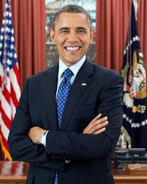

Metonymy
using one aspect of a concept to refer to another aspect of the concept
WHITE HOUSE
PRESIDENT
AND HIS
ADMINISTRATION

Slide 8


Metonymy
using one aspect of a concept to refer to another aspect of the concept
Tree(Apples have beautiful blossoms)
Fruit(Apples are tasty)

Slide 9

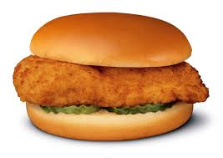
Metonymy
using one aspect of a concept to refer to another aspect of the concept
Animal (That chicken is mean)
Meat (I ate a chicken sandwhich)

Slide 10
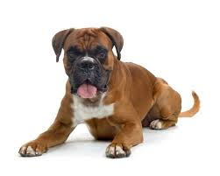
Senses (or concepts)
Semantic representation of a term
dog =

Slide 11
Zeugma
technique for determining if two sense are distinct
Which of those flights serve breakfast?
Does Midwest Express serve Philadelphia?

Slide 12
Zeugma
technique for determining if two sense are distinct
Which of those flights serve breakfast?
Does Midwest Express serve Philadelphia?
? Does Midwest Express serve breakfast
and Philadelphia?

Slide 13
Relations between senses (concepts)

Slide 14
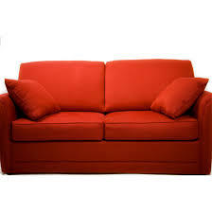
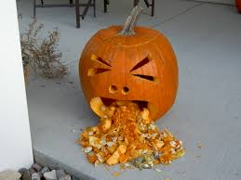
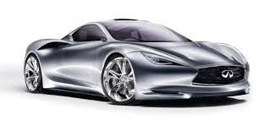
Synonym
vomit/throwup
couch/sofa
car/automobile

Slide 15



Antonymy
light and dark
black and white
hot and cold

Slide 16
Hyponymy (is-a)
denotes subclass of the other
vehicle is a hypernym of car
car is a hyponym of vehicle

Slide 17
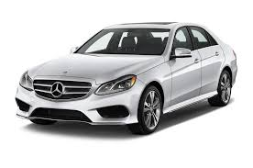
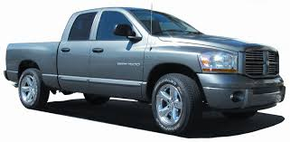
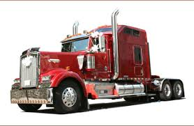
Taxonomy
AUTOMOBILE
is-a
is-a
is-a

Slide 18
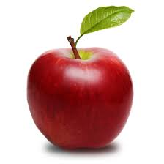
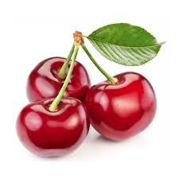
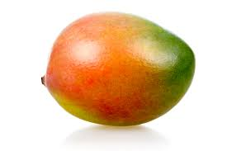
Taxonomy
FRUIT
is-a
is-a
is-a

Slide 19
Lexical Database
Lexicon that contains relationships between the senses
Lexical Databases:
general English domain
WordNet
biomedical domain
Unified Medical Language System

Slide 20
WordNet
developed by Fellbaum, 1998
consists of three separate databases
nouns
verbs
adjectives/adverbs
closed class words (e.g. ‘the’) are not included
http://wordnetweb.princeton.edu/perl/webwn

Slide 21
WordNet 3.0
contains:
117,097 nouns
11,488 verbs
22,141 adjectives
4,601 adverbs
Ambiguity (# senses per word)
noun: 1.23 senses
verb: 2.16 senses

Slide 22
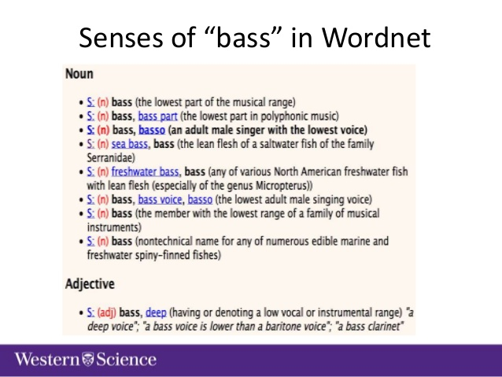
POS
Definition
Synonym Terms
Sentence containing the word

Slide 23
Unified Medical Language System
developed by the National Library of Medicine, National Institute of Health
contains > 2 million biomedical/clinical concepts semi-automatically integrated into a single source

Slide 24
Sources in the UMLS
Medical Subject Headings (MSH)
Systematized Nomenclature of Medicine -- Clinical Terms (SNOMED CT)
Foundational Model of Anatomy (FMA)

Slide 25
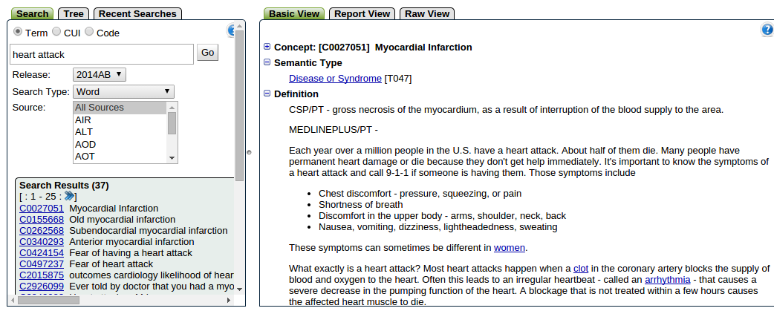
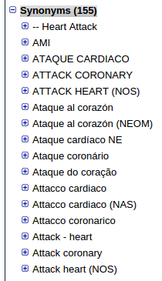
Semantic Type
Definition
Synonym Terms

Slide 26
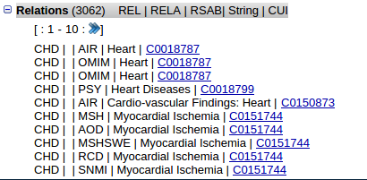
Concept Unique Identifiers (CUIs)
CUIS relations
Hierarchical
PAR/CHD (is-a)
RB/RN (narrower/broader)
Non-hierarchical
SIB (sibling)
RO (other)

Slide 27
Computational Lexical Semantics
Word Similarity
Word Sense Disambiguation
(aka the most fun of all NLP problems)

Slide 28
Semantic Similarity/Relatedness
Relatedness
Similarity

Slide 29
Similarity: is-a relationships
FRUIT
is-a
is-a
is-a

Slide 30
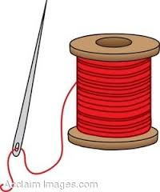

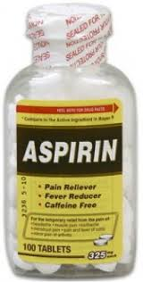

Relatedness
Heart Disease

Slide 31
Why would we use this?
Information retrieval
retrieve documents whose words have
similar meansings to the query words

Slide 32
Why would we use this?
Summarisation
can we substitute one sentence for
another in a particular context

Slide 33
Quantify
the degree of similarity or relatedness between two concepts (or senses)
Similarity
Path-based
Information-content based
Relatedness
Gloss (or definition) based
Distributional Methods

Slide 34
Path-based measures
utilize is-a relations from lexical database
(e.g. WordNet; UMLS)

Slide 35
Path-based measures
utilize is-a relations from lexical database
(e.g. WordNet; UMLS)
Path measure (path)
Wu and Palmer (wup)
Leacock and Chodorow (lch)

Slide 36
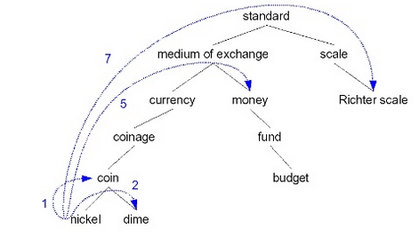
Path measure (path)
sim_path(c1, c2) =
1 / minpath(c1, c2)
sim_path(nickle, dime) = 1 / 2
sim_path(nickle, budget) = ?

Slide 37
Path measure (path)
sim_path(c1, c2) =
1 / minpath(c1, c2)
sim_path(nickle, dime) = 1 / 2
sim_path(nickle, budget) = 1/7

Slide 38
Leacock & Chodorow (lch)
sim_lch(c1, c2) =
-log( minpath(c1,c2) / 2D)
where D = depth of the taxonomy
sim_lch(nickle, dime) = -log(2 / 2D)
sim_lch(nickle, budget) = -log(7/ 2D)

Slide 39
Wu & Palmer (wup)
sim_wup(c1, c2) =
2 * depth( LCS(c1,c2) )
depth(c1) + depth (c2)
depth(c) = how deep it is in the taxonomy
so let standard be the root
of our taxonomy
depth(nickle) = ?

Slide 40
Wu & Palmer (wup)
sim_wup(c1, c2) =
2 * depth( LCS(c1,c2) )
depth(c1) + depth (c2)
depth(c) = how deep it is in the taxonomy
so let standard be the root
of our taxonomy
depth(nickle) = 6

Slide 41
Wu & Palmer (wup)
sim_wup(c1, c2) =
2 * depth( LCS(c1,c2) )
depth(c1) + depth (c2)
LCS = least common subsumer
the concept c1 and c2 have in common
as you move up the tree

Slide 42
Wu & Palmer (wup)
sim_wup(c1, c2) =
2 * depth( LCS(c1,c2) )
depth(c1) + depth (c2)
LCS = least common subsumer
LCS(nickle, dime) = coin

Slide 43
Wu & Palmer (wup)
sim_wup(c1, c2) =
2 * depth( LCS(c1,c2) )
depth(c1) + depth (c2)
LCS = least common subsumer
LCS(nickle, fund) = ?

Slide 44
Wu & Palmer (wup)
sim_wup(c1, c2) =
2 * depth( LCS(c1,c2) )
depth(c1) + depth (c2)
LCS = least common subsumer
LCS(nickle, fund) = medium of exchange

Slide 45
Wu & Palmer (wup)
sim_wup(c1, c2) =
2 * depth( LCS(c1,c2) )
depth(c1) + depth (c2)
sim_wup(nickle, dime) =
2 * depth(coin)
depth(nickle) + depth(dime)
= (2 * 5) / (6 + 6) = 10/12 = 5/6

Slide 46
Path-based measures recap
Path-based measures use the path information
between the concepts to quantify their similarity
What I want you to remember about path-based similarity measures!!

Slide 47
Information content (IC) measures
Utilize path information but also incorporate
the probability of the concept occurring in text

Slide 48
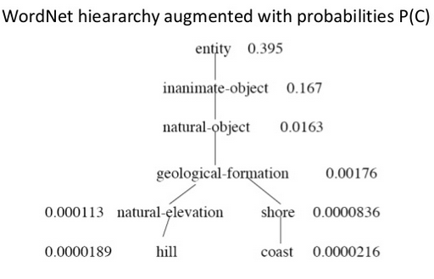
Information Content
The lower a node is in the hierarchy, the lower the probability
IC(c) = -log(P(c))
IC(hill) = -log(0.0000189)

Slide 49
Information content (IC) measures
Utilize path information but also incorporate probability of the concept occurring in text
Resnik
Lin
Jiang & Conrath

Slide 50
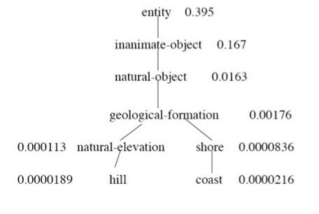
Resnik (res)
sim_res(c1, c2) = - log(P(LCS(c1, c2))
sim_res(hill, coast) =
-log(P(LCS(hill, coast)) =
-log(P(LCS(geological-formation) =
-log(P(0.00179)

Slide 51
Lin (lin) & Jiang & Conrath (jcn)
sim_lin(c1, c2) =
2 * IC(LCS(c1, c2))
IC(c1) + IC(c2)
sim(jcn(c1, c2) =
1
IC(c1) + IC(c2) - 2 (IC(LCS(c1,c2)))
Let’s calculate: sim_lin(hill, coast) on the board

Slide 52
Lin (lin) & Jiang & Conrath (jcn)
sim_lin(c1, c2) =
2 * IC(LCS(c1, c2))
IC(c1) + IC(c2)
sim(jcn(c1, c2) =
1
IC(c1) + IC(c2) - 2 (IC(LCS(c1,c2)))
Let’s calculate: sim_lin(hill, coast) on the board
2 * IC(LCS(hill, cost))
IC(hill) + IC(cost)

Slide 53
Lin (lin) & Jiang & Conrath (jcn)
sim_lin(c1, c2) =
2 * IC(LCS(c1, c2))
IC(c1) + IC(c2)
sim(jcn(c1, c2) =
1
IC(c1) + IC(c2) - 2 (IC(LCS(c1,c2)))
Let’s calculate: sim_lin(hill, coast) on the board
2 * IC(geological-formation)
IC(hill) + IC(cost)

Slide 54
Lin (lin) & Jiang & Conrath (jcn)
sim_lin(c1, c2) =
2 * IC(LCS(c1, c2))
IC(c1) + IC(c2)
sim(jcn(c1, c2) =
1
IC(c1) + IC(c2) - 2 (IC(LCS(c1,c2)))
Let’s calculate: sim_lin(hill, coast) on the board
2 * 0.00176
0.0000189 + 0.0000216

Slide 55
Lin (lin) & Jiang & Conrath (jcn)
sim_lin(c1, c2) =
2 * IC(LCS(c1, c2))
IC(c1) + IC(c2)
sim(jcn(c1, c2) =
1
IC(c1) + IC(c2) - 2 (IC(LCS(c1,c2)))
Let’s calculate: sim_lin(hill, coast) on the board
2 * 0.00176
0.0000189 + 0.0000216
Ratio of IC of there first common ancestor divided by
Their individual ICs – the higher up the ancestor the
Greater the IC – therefore the smaller the ratio

Slide 56
IC-based measure
IC-based measures use the path information
but also incorporate the probability of the concept

Slide 57
Relatedness measures
utilize some contextual information about the concepts
Definition-based measures
Extended Lesk
Distributional-based measures
Co-occurence/Bigram Vectors
2nd order Co-occurrence/Bigram Vectors

Slide 58
Adapted Lesk (lesk)
based on the overlaps between the two concepts extended definitions
∑ (length overlap)^2
drawing paper: paper that is specially prepared for use in drafting
decal: the art of transferring designs from specially prepared paper to a wood
sim_lesk(drawing paper, decal) = 1^2 + 2^2 = 1 + 4 = 5

Slide 59
Extended Definition
extended definition(c) =
definition of c +
definition of c’s
related concepts
extended definition of
nickel would include
coins definition

Slide 60
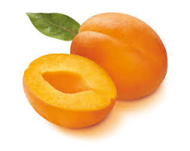
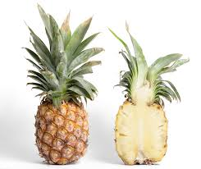
Vector methods
pineapple
similarity
apricot

Slide 61

Co-occurrence Vector
UMLS OR WORDNET DEFINITIONS
or
EXTERNAL CORPUS
Definition(pineapple) contains the words:
boil
large
sugar
water
Definition(apricot) contains the words:
boil
sugar
water
context
words

Slide 62
Distance
Vector Similarity:
Manhatten Distance
Levenshtein distance
L1 norm
Euclidean Distance
Cosine
normalized Dot product
Jaccard
Dice
Kullback Leibler (KL) divergence
relative entropy
Jenson-Shannon divergence
pineapple
sim
apricot

Slide 63

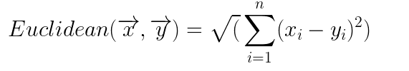
Euclidean and Manhattan
Rarely used for word similarity because they are sensitive to extreme values

Slide 64

Cosine
Normalized dot product

Slide 65
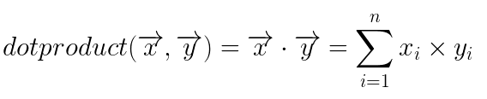
Cosine
Normalized dot product

Slide 66
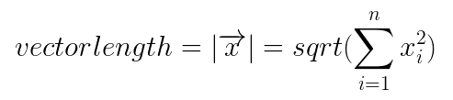
Cosine
Normalized dot product

Slide 67
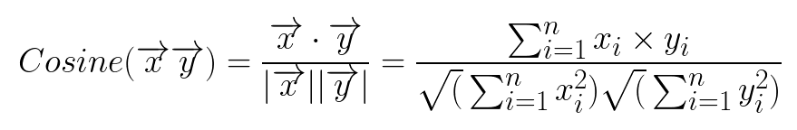
Cosine

Slide 68
Problems : Sparsity
Singular Value Decomposition (SVD)
2nd order co-occurrence/bigram vectors

Slide 69
2nd order Co-occurrence Vector
tart | 0 | 1 | 0 | 1 | 0 | 0 | 0 | 1
hand | 0 | 0 | 0 | 1 | 0 | 0 | 0 | 0
salt | 0 | 1 | 0 | 0 | 1 | 1 | 0 | 1
fruit | 0 | 1 | 0 | 0 | 1 | 1 | 0 | 1
open | 0 | 0 | 0 | 0 | 0 | 0 | 0 | 0
solution | 0 | 1 | 1 | 1 | 0 | 0 | 0 | 1
boil | 0 | 1 | 0 | 0 | 1 | 1 | 0 | 1
simmer | 0 | 1 | 0 | 0 | 0 | 0 | 0 | 0
External corpus
DEF
words

Slide 70
2nd order Co-occurrence Vector
tart | 0 | 1 | 0 | 1 | 0 | 0 | 0 | 1
hand | 0 | 0 | 0 | 1 | 0 | 0 | 0 | 0
salt | 0 | 1 | 0 | 0 | 1 | 1 | 0 | 1
fruit | 0 | 1 | 0 | 0 | 1 | 1 | 0 | 1
open | 0 | 0 | 0 | 0 | 0 | 0 | 0 | 0
solution | 0 | 1 | 1 | 1 | 0 | 0 | 0 | 1
boil | 0 | 1 | 0 | 0 | 1 | 1 | 0 | 1
simmer | 0 | 1 | 0 | 0 | 0 | 0 | 0 | 0
3/8
1/8
4/8
4/8
0
4/8
4/8
1/8
AV
GERAGE
words

Slide 71
2nd order Co-occurrence Vector
tart | 0 | 1 | 0 | 1 | 0 | 0 | 0 | 1
hand | 0 | 0 | 0 | 1 | 0 | 0 | 0 | 0
salt | 0 | 1 | 0 | 0 | 1 | 1 | 0 | 1
fruit | 0 | 1 | 0 | 0 | 1 | 1 | 0 | 1
open | 0 | 0 | 0 | 0 | 0 | 0 | 0 | 0
solution | 0 | 1 | 1 | 1 | 0 | 0 | 0 | 1
boil | 0 | 1 | 0 | 0 | 1 | 1 | 0 | 1
simmer | 0 | 1 | 0 | 0 | 0 | 0 | 0 | 0
3/8
1/8
4/8
4/8
0
4/8
4/8
1/8
AV
GERAGE
words

Slide 72
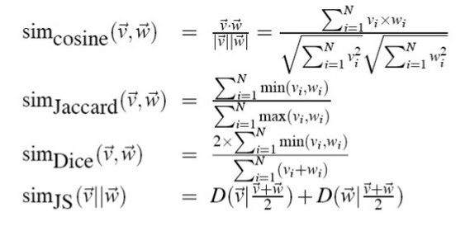
Same Distance Metrics
on 2nd order vectors
3/8
1/8
4/8
4/8
0
4/8
4/8
1/8
sim
apricot
pineapple
JS = Jenson-Shannon divergence

Slide 73
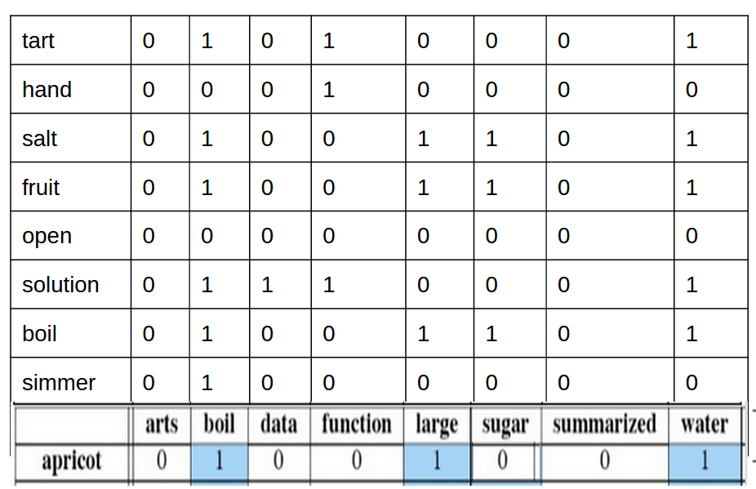
Connecting dots: Ngram Statistics
Measures of Association
Log Likelihood Ratio
Chi Squared
Mutual Information
Odds Ratio
etc …

Slide 74
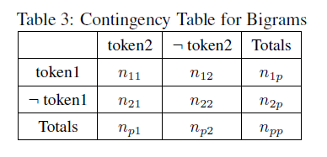
Bigram

Slide 75
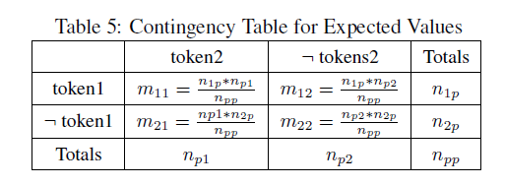
Expected Values

Slide 76
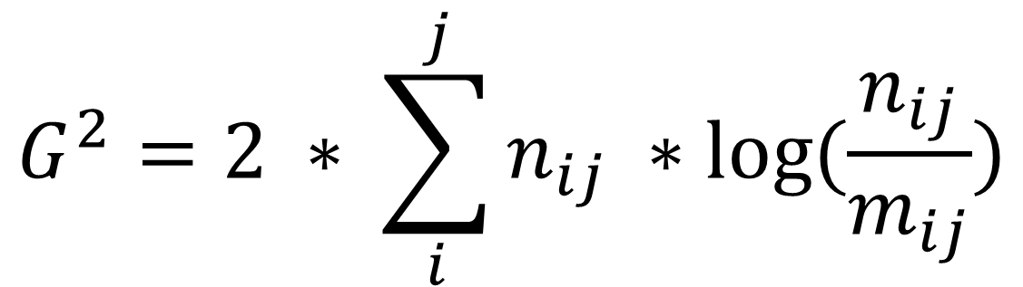
Log Likelihood Ratio
(Dunning, 1993)

Slide 77
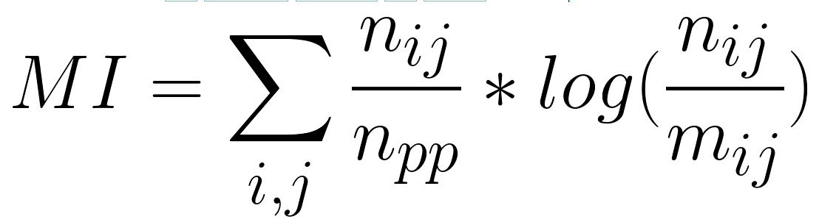
Mutual Information
Church & Hanks (1989)

Slide 78
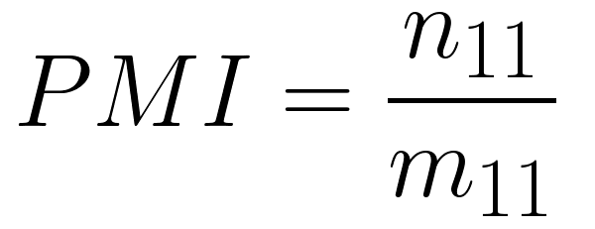
Pointwise Mutual Information
(Fano 1961)

Slide 79
Using Measures of Association
Log Likelihood Ratio
Chi Squared
Mutual Information
Odds Ratio
etc …

Slide 80
Evaluation Similarity
Intrinsic Evaluation
Correlation with human judgements
Spearman’s Rank Correlation
Extrinsic Evaluation
Spelling error detection
Word Sense Disambiguation
Essay grading

Slide 81
Intrinsic Evaluation
4.0<>Renal failure<>Renal failure
3.0<>Heart<>Myocardium
3.0<>Stroke<>Infarct
3.0<>Abortion<>Miscarriage
3.0<>Delusion<>Schizophrenia
2.7<>Congestive heart failure<>Pulmonary edema
2.7<>Tumor metastasis<>Adenocarcinoma
2.3<>Calcification<>Stenosis
2.0<>Diarrhea<>Stomach cramps
2.0<>Mitral stenosis<>Atrial fibrillation
How correlated are the measures to those of human judges
Semantic
Similarity
And
Relatedness
System
Evaluation: Spearman’s Rank Correlation
Lexical
Database
Correlation
Renal failure<>Renal failure
Heart<>Myocardium
Stroke<>Infarct
Abortion<>Miscarriage
Delusion<>Schizophrenia
Congestive heart failure<>Pulmonary edema
Tumor metastasis<>Adenocarcinoma
Calcification<>Stenosis
Diarrhea<>Stomach cramps
Mitral stenosis<>Atrial fibrillation
1.0000<>Renal failure<>Renal failure
0.8571<>Heart<>Myocardium
0.2353<>Stroke<>Infarct
0.8421<>Abortion<>Miscarriage
0.2727<>Delusion<>Schizophrenia
0.7861<>Congestive heart failure<>Pulmonary edema
0.2587<>Tumor metastasis<>Adenocarcinoma
0.2000<>Calcification<>Stenosis
0.5000<>Diarrhea<>Stomach cramps
0.7333<>Mitral stenosis<>Atrial fibrillation

Slide 82
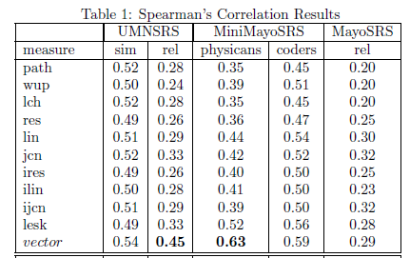

Slide 84
Is the difference in these results statistically significant?

Slide 85
Statistical Significance
We see some differences in the results,
and want to know if those differences are
likely due to chance.
To determine this we calculate the p-value
if the p-value is less than the significance level (e.g. p<0.05) then we can conclude that the observed effect actually reflects the characteristics of our data rather than just by chance

Slide 86
Fisher r-to-z transformation
Hypotheses about the value of the population correlation coefficient rho between variables X and Y can be tested using Fisher transformation.

Slide 87
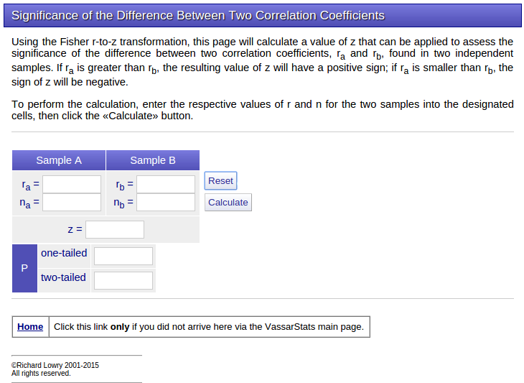

Slide 88
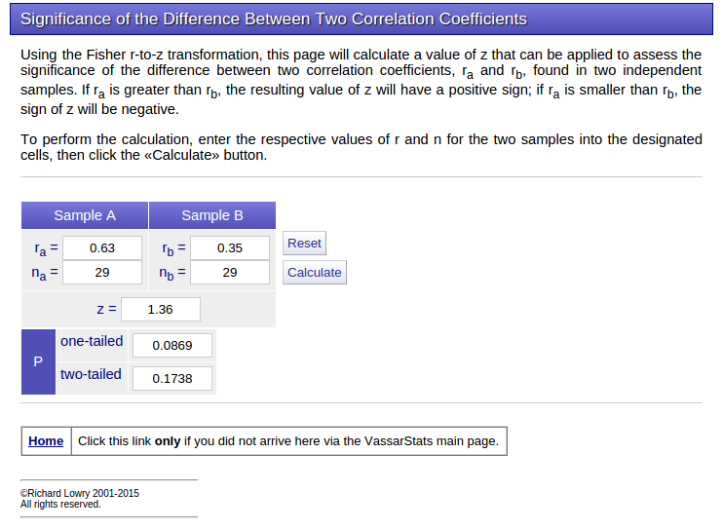

Slide 89
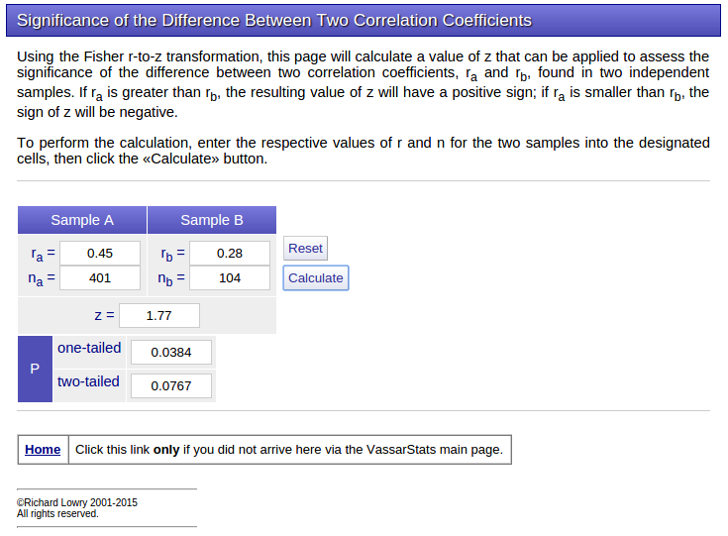

Slide 90
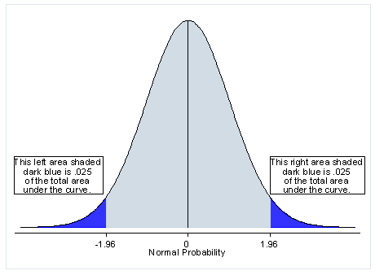
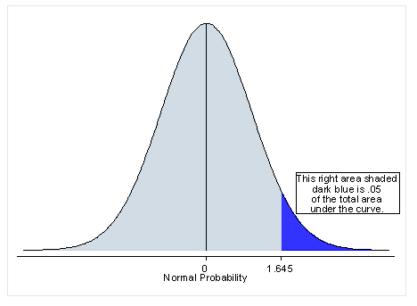

Slide 91
Extrinsic Evaluation
Knowledge-based WSD: Use information from an external knowledge base and or corpora

Slide 92
Knowledge-based Algorithms
SenseRelate: uses our similarity and relatedness measures

Slide 93
SenseRelate algorithm
Each possible sense of a target word is assigned a score
[sum similarity between it and its surrounding terms]
Assign target word the sense with highest score

Slide 94
SenseRelate example
Busprione attenuates tolerance to morphine
in mice with skin cancer

Slide 95
SenseRelate example
Busprione attenuates tolerance to morphine
in mice with skin cancer
Drug
Tolerance:
C0013220
Immune
Tolerance:
C0020963

Slide 96
SenseRelate example
Busprione attenuates tolerance to morphine
in mice with skin cancer
Drug
Tolerance:
C0013220
Immune
Tolerance:
C0020963
Busprione:
C0006462
Morphine:
C0026549
Mice:
C0026809
Skin cancer:
C0007114

Slide 97
SenseRelate example
Part II
Busprione attenuates tolerance to morphine
in mice with skin cancer
Drug
Tolerance:
C0013220
Immune
Tolerance:
C0020963
0.11
0.09
0.09
0.16
Busprione:
C0006462
Morphine:
C0026549
Mice:
C0026809
Skin cancer:
C0007114

Slide 98
SenseRelate example
Busprione attenuates tolerance to morphine
in mice with skin cancer
Drug Tolerance
Score = 0.09 + 0.09 + 0.16 + 0.11 = 0.45
Drug
Tolerance:
C0013220
Immune
Tolerance:
C0020963
0.11
0.09
0.09
0.16
Busprione:
C0006462
Morphine:
C0026549
Mice:
C0026809
Skin cancer:
C0007114

Slide 99
SenseRelate example
Part II
Busprione attenuates tolerance to morphine
in mice with skin cancer
Drug Tolerance
Score = 0.09 + 0.09 + 0.16 + 0.11 = 0.45
Drug
Tolerance:
C0013220
Immune
Tolerance:
C0020963
0.11
0.09
0.09
0.09
0.04
0.16
0.09
0.05
Busprione:
C0006462
Morphine:
C0026549
Mice:
C0026809
Skin cancer:
C0007114

Slide 100
SenseRelate example
Busprione attenuates tolerance to morphine
in mice with skin cancer
Drug Tolerance
Score = 0.09 + 0.09 + 0.16 + 0.11 = 0.45
Immune Tolerance
Score = 0.09 + 0.09 + 0.05 + 0.05 = 0.27
Drug
Tolerance:
C0013220
Immune
Tolerance:
C0020963
0.11
0.09
0.09
0.09
0.04
0.16
0.09
0.05
Busprione:
C0006462
Morphine:
C0026549
Mice:
C0026809
Skin cancer:
C0007114

Slide 101
SenseRelate example
Busprione attenuates tolerance to morphine
in mice with skin cancer
Drug Tolerance
Score = 0.09 + 0.09 + 0.16 + 0.11 = 0.45
Immune Tolerance
Score = 0.09 + 0.09 + 0.05 + 0.05 = 0.27
Drug
Tolerance:
C0013220
Immune
Tolerance:
C0020963
0.11
0.09
0.09
0.09
0.04
0.16
0.09
0.05
Busprione:
C0006462
Morphine:
C0026549
Mice:
C0026809
Skin cancer:
C0007114

Slide 102
Sense Relate Assumption
An ambiguous word is often used in the sense
that is most similar to the sense of the
terms that surround it

Slide 103
[sum similarity between it and its surrounding terms]
Similarity and Relatedness Measures:
Path-based similarity measures
IC-based similarity measures
Relatedness measures
So for a quick recap: what is it that I wanted you to remember about each of the measures?

Slide 104
Evaluation
Accuracy:
The percentage of words tagged identically with the hand-labeled sense tags in the test set
Test
instances
containing the ambiguous word
<instance id="line-n.w8_059:8174:">
<context>
<s> The integrated services digital network, or ISDN, is an international standard used to transmit voice, data, graphics and video images over telephone <head>lines</head> . </s>
</context>
WSD
Algorithm
assigned sense
Key
For Test
check if they are the same
<answer instance="line-n.w8_059:8174:" senseid="phone"/>

Slide 105
MFS baseline
MFS Baseline | Your algorithm
Accuracy (%) | Accuracy (%)
Most frequent sense
Assign each instance in the test data the most
frequent sense from the training data
Test
instances
containing the ambiguous word
Key
For Test
Training instances
containing the ambiguous word
Find Sense assigned to the most number of instances
Assign sense to test instances
And
Calculate Accuracy
MFS Baseline

Slide 106
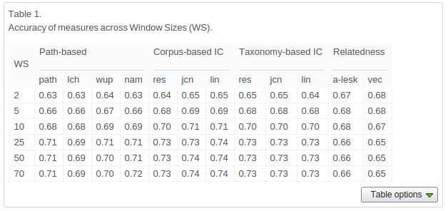

Slide 108
Student’s T-test
Determine if two sets of data are significantly different from each other
Pairwise Student’s T-test
used when the two samples have been paired

Slide 109
Example
http://graphpad.com/quickcalcs/ttest1/?Format=C
https://docs.google.com/spreadsheets/d/17GBN9tYeD2HO1K8wxNmc37XxwZMzBUApxFZflZAgEg8/edit#gid=0
average |  | 0.5447802956 | 0.7404679803 | 0.7005960591
category | target word | majority sense | lin | wup

Slide 110
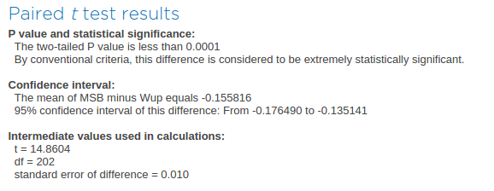
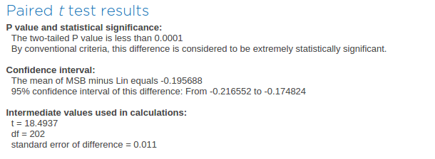
Majority Sense Comparison

Slide 111
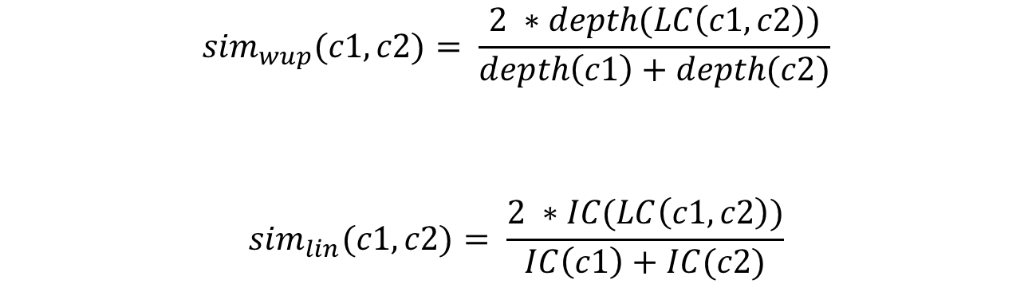
wup (path-based measure) verus lin (IC-based measure)
$${sim}_{wup}(c1, c2)= \frac{2 ∗depth(LC\left(c1,c2\right))}{depth\left(c1\right)+depth(c2)}$$
$${sim}_{lin}(c1, c2)= \frac{2 ∗IC(LC\left(c1,c2\right))}{IC\left(c1\right)+IC(c2)}$$

Slide 112
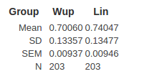
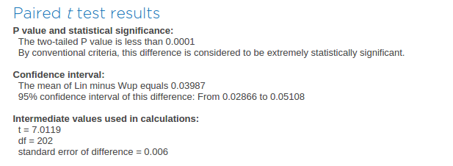
t-test results

Slide 113
Statistical Significance
We see some differences in the results,
and want to know if those differences are
likely due to chance.
To determine this we calculate the p-value
if the p-value is less than the significance level (e.g. p<0.05) then we can conclude that the observed effect actually reflects the characteristics of our data rather than just by chance

